Slide 1

Architecting Windows Phone Apps
with Caliburn Micro
WPH302
Keith Patton - @kpatton
Technical Director
www.markerstudio.com

Slide 2
Caliburn Micro
What and Why?
Caliburn Micro is an MVVM Framework
Cleaner architecture – separation of concerns
Faster app development
Less plumbing code
More maintainable code
More testable code
More fun!

Slide 3
Caliburn Micro
What we’ll be covering today….
Getting Started with Caliburn Micro
Lifecycle Management for Apps and View Models (VMs)
Managing the App Bar and performing Navigation
Pivot Pages made easy
Tombstoning with ease
Simplifying Messaging, Launchers and Choosers
Simplifying Async with Coroutines
MVVM Video Player Demo

Slide 4
Getting Started with Caliburn Micro
Strapping up those boots….
http://caliburnmicro.codeplex.com
NuGet support! Install-package Caliburn.Micro
  Clean out your App.xaml.cs file
  Add the AppBootstrapper to your App.xaml's Resources section.
  DEMO - Conventional Binding based on x:Name

Slide 5
Getting Started with Caliburn Micro
AppBootstrapper Summary…
This is App.xaml.cs on STEROIDS!
Use Configure() to register VMs and other objects
Uses a Dependency Injection approach
Enables granular App Lifecycle Management...

Slide 6
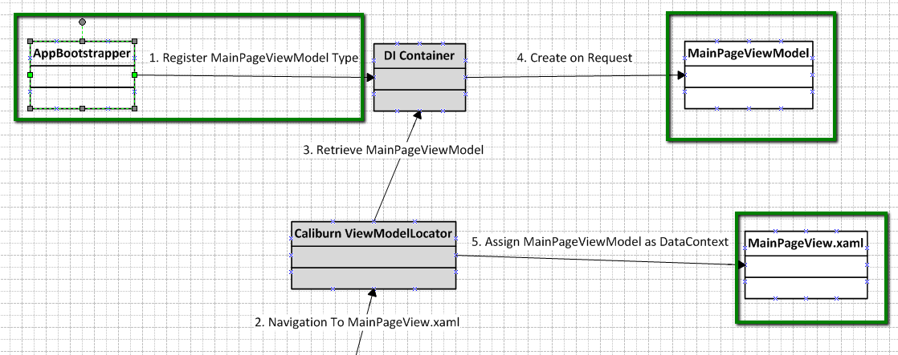
Getting Started with Caliburn Micro
So what’s Caliburn doing?

Slide 7
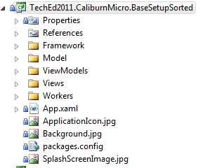
Getting Started with Caliburn Micro
Folder structure and conventions
Adopt a consistent folder structure
Suffix your Views and ViewModels
Caliburn conventions work automatically!

Slide 8
Getting Started
In Summary
Use NuGet to install Caliburn Micro to your project
Clean up your App.xaml/.cs
Use AppBootstrapper to control your application
Adopt a consistent folder structure and stick to it

Slide 9
Caliburn Lifecycle Management 1
Controlling App Lifecycle Management
DEMO – some message boxes!
Use AppBootstrapper for granular app lifecycle management
You can use overrides or handle some events for more advanced hooks (which are coming in Mango)
As with App.xaml.cs, useful for saving stat, handling and unhandled exceptions etc.

Slide 10
Caliburn Lifecycle Management 3
Screen Lifecycle Hooks
DEMO – Fancy listbox displaying strings!
Lifecycle in your VM, not in your View!
OnViewAttached – View is wired to VM
OnInitialize – Once only call before first OnActivated
OnActivate – View navigated to or brought into view
OnViewReady – After OnActivated, do heavy lifting here!
OnViewLoaded – View is loaded
OnDeactivate – View navigated from or taken out of view

Slide 11
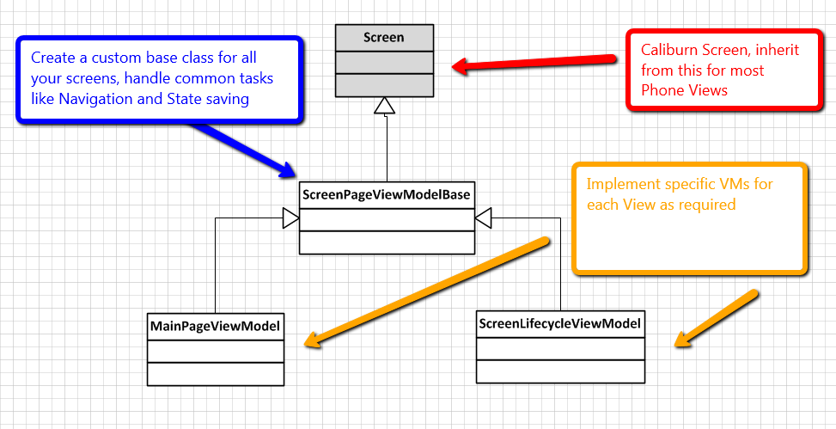
Caliburn Lifecycle Management 3
Screen View Model Hierarchy

Slide 12
Caliburn Navigation
Navigation and the App Bar
DEMO – Button Navigation
DEMO – App Bar Management
Strongly typed navigation with fluent style
Automatically set properties on target VM
Use CM AppBarButton and AppBarMenuItem
Ability to set ‘Message’ which binds to VM method
Offload Navigation to a NavigationWorker, with DI

Slide 13
Caliburn Micro
Deep Breath…
We’ve covered...
  Setting up Caliburn Micro
  Using conventional binding and action messages
  Leveraging App and VM lifecycle hooks
  Simplifying navigation and app bar management

Slide 14
Caliburn Pivots
Introducing the Conductor
DEMO – Fancy pivot control page!
The Conductor provides control over multiple Views
Pivots are Conductors with a single active View
Conductor’s Items and ActiveItem properties are bound to the Pivot’s Items and Selected Item properties
Conductor’s ActivateItem method used to set the active Pivot Item.
Pivot Item Views are standard user controls. Inherit from Screen to take advantage of lifecycle hooks

Slide 15
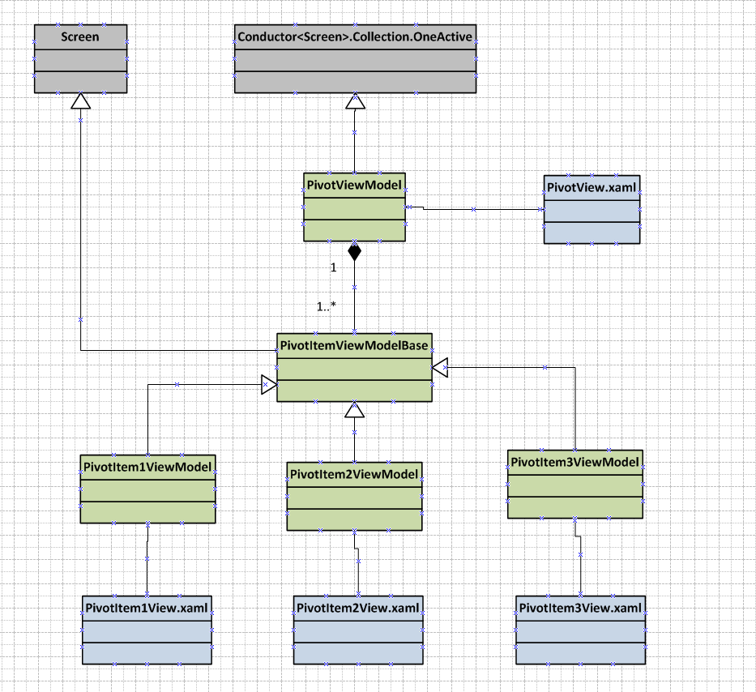

Slide 16
Caliburn Pivots
Advantages of the Conductor approach
Easier maintenance, separate View/VM for each pivot item
Cleaner, with VMs only to control Pivot
Full lifecycle support for Pivot Item VMs
Performance control. Delay loading items until required via binding to the Pivot Item Changed event

Slide 17
Caliburn Tombstoming
Easily save VM state
DEMO – Automatically save state!
Create a StorageHandler for your VM
Fluent api to express how state should be saved/restored
Save in phone state or AppSettings (iso storage)

Slide 18
Caliburn Micro Messaging
Using the EventAggregator
DEMO – Pivot item timestamp display!
Simple Publish/Subscribe messaging
Loose coupling across VMs and Views
Implement IHandle<T> on your VM/View
Subscribe/Unsubscribe using Lifecycle Hooks

Slide 19
Caliburn Micro
Simplifying Launchers and Choosers
DEMO – Picking a contact!
Uses the EventAggregator
Use EventAggregator.RequestTask<T>
Subscribe to IHandle<TaskCompleted<T>>
Clean and simple

Slide 20
Caliburn Micro
Easy Async With Coroutines
DEMO – doing a background task!
Sequential layout, mixed sync/async activities
Do now what’s coming in C# 5.0 async!
layout easier to read and maintain
Best used for more complex async requirements

Slide 21
Caliburn Micro – Putting it all Together
MVVM Video Player Demo
DEMO – No code behind!
Player State controlled via VM Bindings
Action Messages for MediaElement events
Conventional Binding for Buttons and TextBlocks
Subscribe to IHandle<TaskCompleted<T>>
Clean and simple

Slide 22
Caliburn Micro
Useful Links
http://caliburnmicro.codeplex.com
http://caliburnmicro.codeplex.com/documentation
www.markerstudio.com/blog

Slide 23




Resources
Learning
  Connect. Share. Discuss.
  Microsoft Certification & Training Resources
http://newzealand.msteched.com
www.microsoft.com/learning
  Resources for IT Professionals
  Resources for Developers
http://microsoft.com/technet
http://microsoft.com/msdn

Slide 24
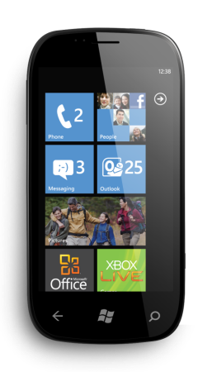
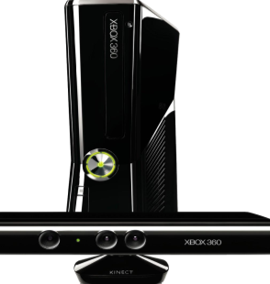
Evaluate your sessions
on CommNet and go in
the draw to win instant
prizes

Slide 25

© 2011 Microsoft Corporation. All rights reserved. Microsoft, Windows, Windows Vista and other product names are or may be registered trademarks and/or trademarks in the U.S. and/or other countries.
The information herein is for informational purposes only and represents the current view of Microsoft Corporation as of the date of this presentation. Because Microsoft must respond to changing market conditions, it should not be interpreted to be a commitment
on the part of Microsoft, and Microsoft cannot guarantee the accuracy of any information provided after the date of this presentation. MICROSOFT MAKES NO WARRANTIES, EXPRESS, IMPLIED OR STATUTORY, AS TO THE INFORMATION IN THIS PRESENTATION.

